Slide 1
Using Automated Machine Learning to Predict NBA Player replacement
Final Project – Group 1 – NBA Player Replacement

Slide 2



TEAM MEMBERS:
Juan Ulloa | ulloajuan@hotmail.com
Adam Burstyn | adam.burstyn@gmail.com
Ignacio Domaica | idomaica@gmail.com

Slide 3
AGENDA
PROJECT DESCRIPTION
PROJECT REQUIREMENTS
SOURCES
ETL
EXTRACTION
TRANSFORMATION
LOAD
USER INTERFACE & VISUALIZATIONS
CONCLUSIONS

Slide 4

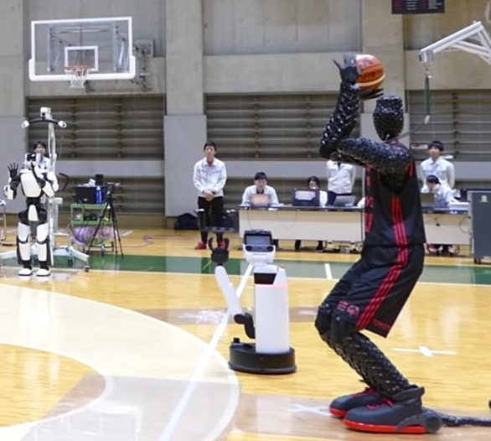
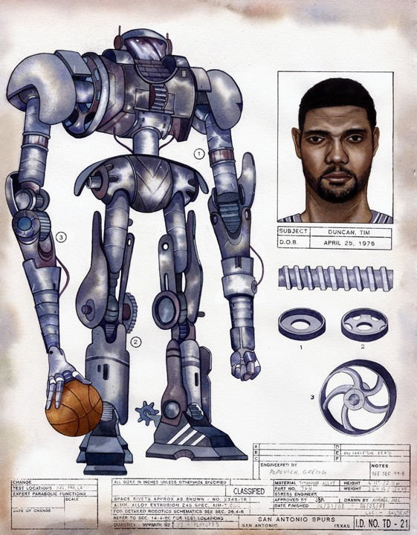

Project title
NBA player robot replacer
Using Automated Machine Learning to Predict NBA Player replacement

Slide 5
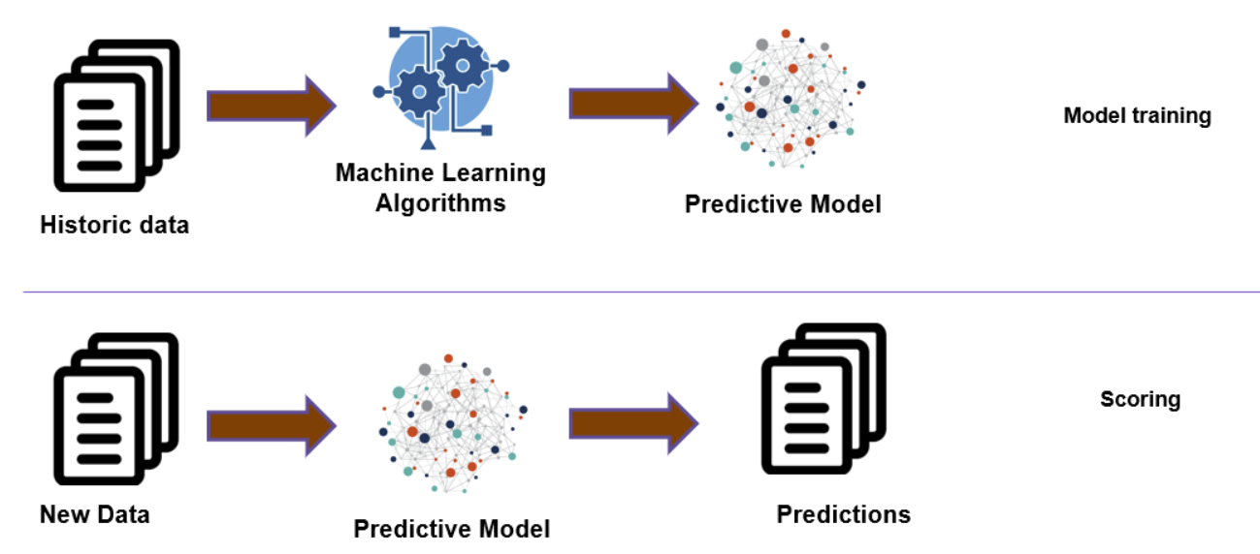
Description & Scope
The idea would be to determine which player is best suited to fill a certain position on any NBA team based on existing players and-or including draftees or not.

Slide 6

Main TECHNOLOGIES used to deploy this project
’Plotly’
’Streamlit’
‘Matplotlib’. Cross-platform for data visualization and graphical plotting library for Python
‘Sklearn’
Linear Regression.
Random forest classifier used compare the performance of last year NCAA statistics to NBA stats trying to

Slide 7
AGENDA
PROJECT DESCRIPTION
PROJECT REQUIREMENTS
SOURCES
ETL
EXTRACTION
TRANSFORMATION
LOAD
USER INTERFACE & VISUALIZATIONS
CONCLUSIONS

Slide 8
Suggested Final Project: Demystifying ML
01
Find a problem worth solving, analyzing, or visualizing.
02
Use ML in the context of technologies learned.
03
You must use: Scikit-Learn and/or another machine learning library.
You must use at least two of the below:
04
Python Pandas Python Matplotlib | HTML/CSS/Bootstrap JavaScript Plotly JavaScript D3.js | JavaScript Leaflet SQL Database MongoDB Database | Google Cloud SQL Amazon AWS Tableau

Slide 9
AGENDA
PROJECT DESCRIPTION
PROJECT REQUIREMENTS
SOURCES
ETL
EXTRACTION
TRANSFORMATION
LOAD
USER INTERFACE & VISUALIZATIONS
CONCLUSIONS

Slide 10

SOURCES
DATA.- Collected from:
Kaggle
NBA stats
NCAA stats
https://www.basketball-reference.com/leagues/NBA_2021.html
https://hoopshype.com/salaries/players/
Format used has been .csv (Comma Separated Values)
MAIN CHARACTERISTICS
Pretty straight forward process
Abundance of data & statistics
Standardized data

Slide 11
AGENDA
PROJECT DESCRIPTION
PROJECT REQUIREMENTS
SOURCES
ETL
EXTRACTION
TRANSFORMATION
LOAD
USER INTERFACE & VISUALIZATIONS
CONCLUSIONS

Slide 12
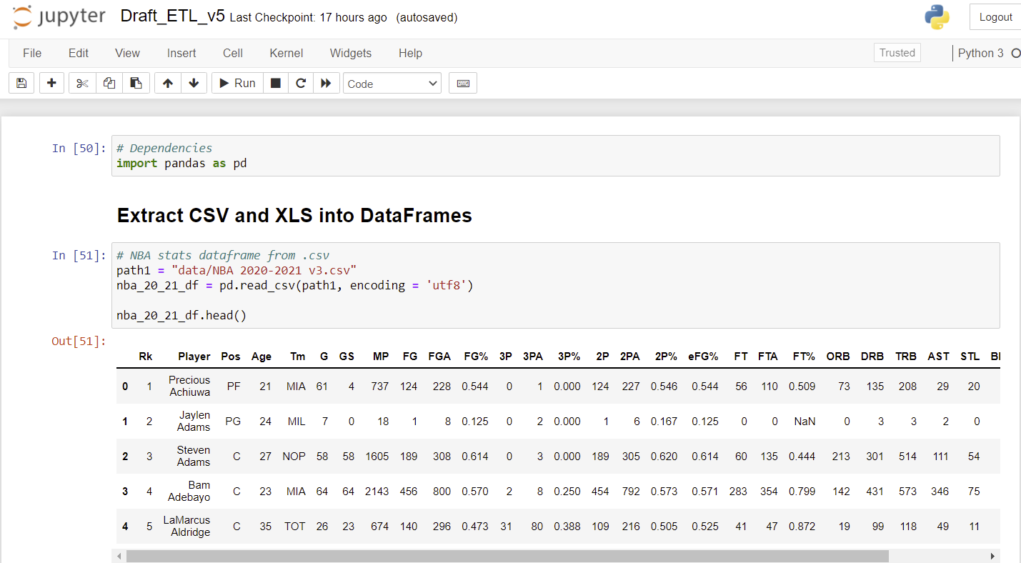
EXTRACTION
Dependencies

Slide 13
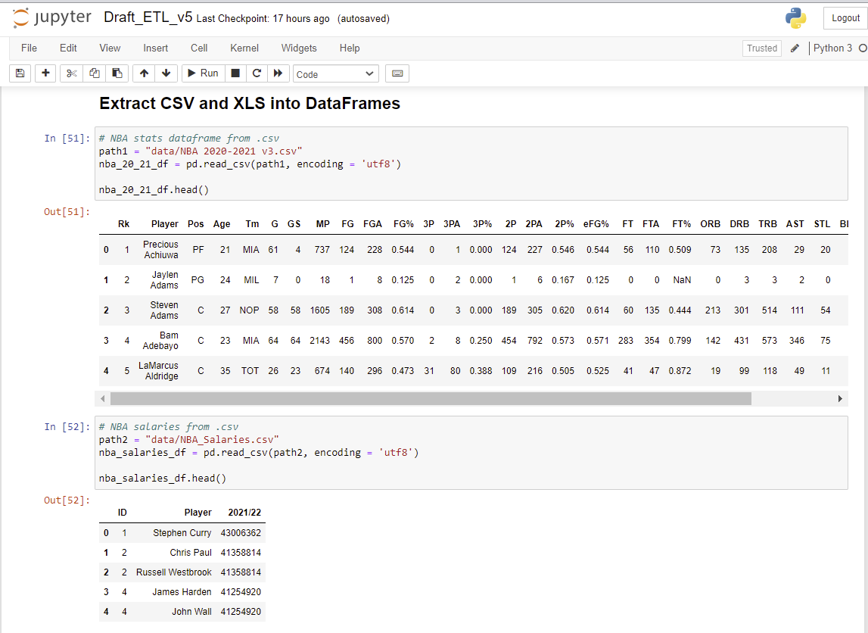
EXTRACTION. Reading .csv for stats & Salaries

Slide 14
AGENDA
PROJECT DESCRIPTION
PROJECT REQUIREMENTS
SOURCES
ETL
EXTRACTION
TRANSFORMATION
LOAD
USER INTERFACE & VISUALIZATIONS
CONCLUSIONS

Slide 15
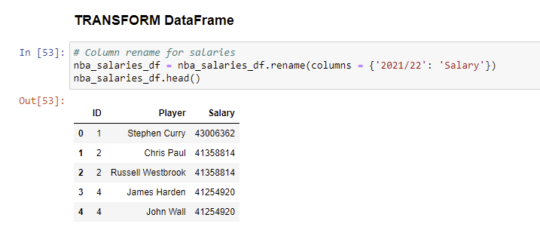
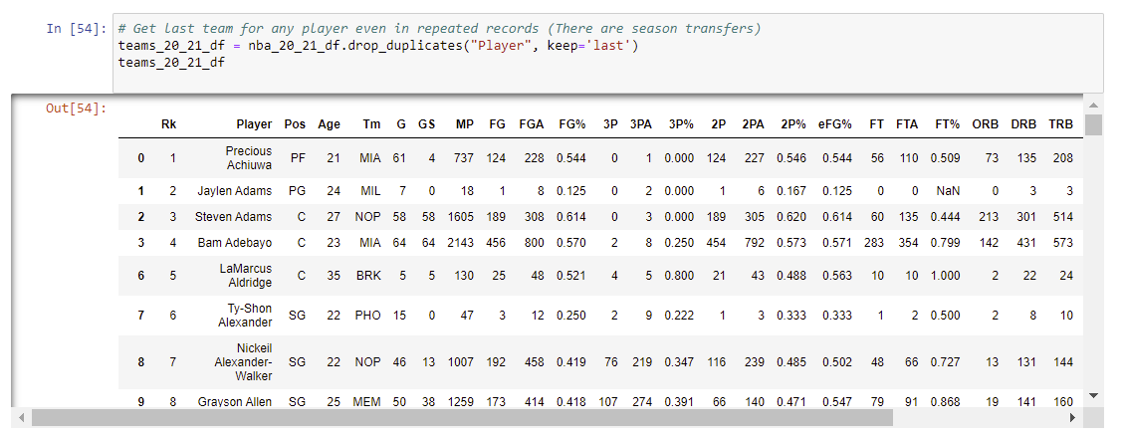
TRANSFORMATION #1. To produce statistical cleaned data
Rename
Get last team of a player dropping duplicates

Slide 16
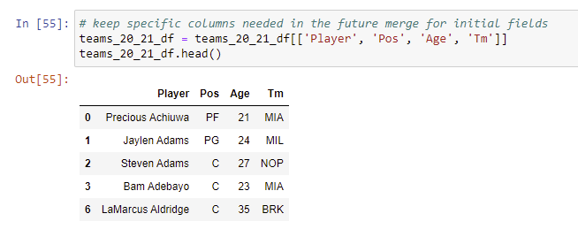
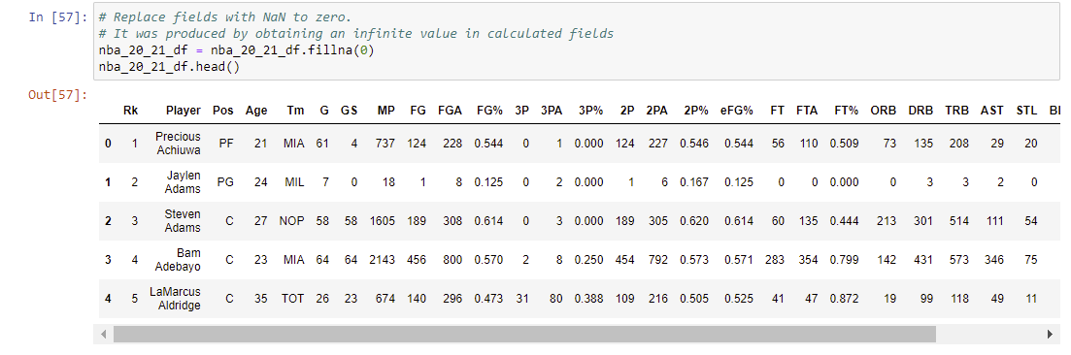
TRANSFORMATION #1. To produce statistical cleaned data
Get dataframe with initial columns needed for specific player
Begin transformation of rest of data

Slide 17
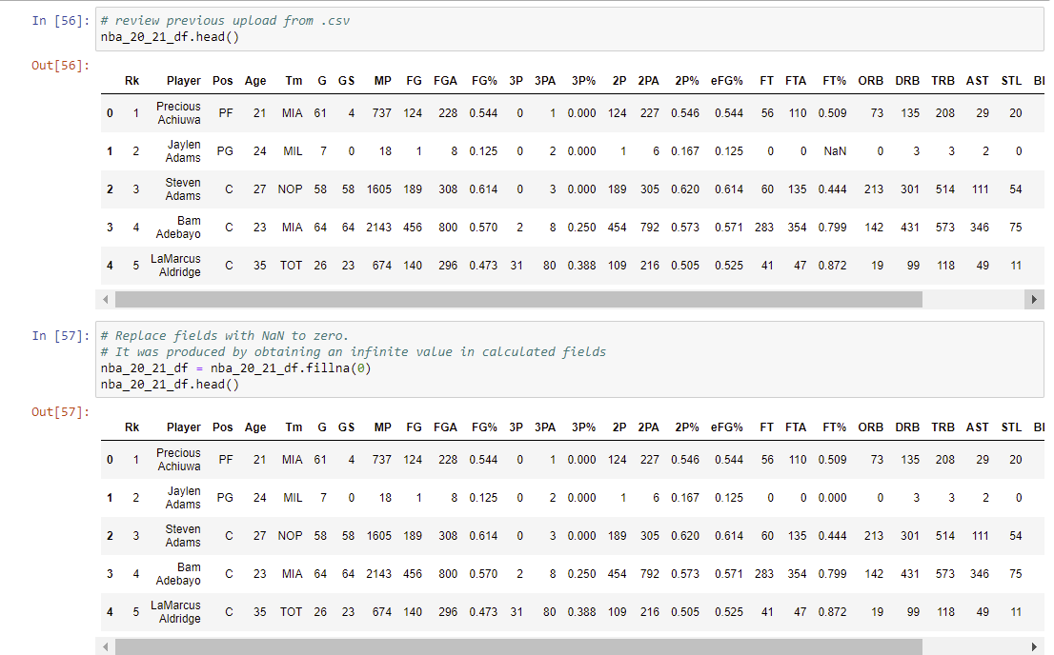
TRANSFORMATION #1. To produce statistical cleaned data
Begin transformation for rest of data

Slide 18
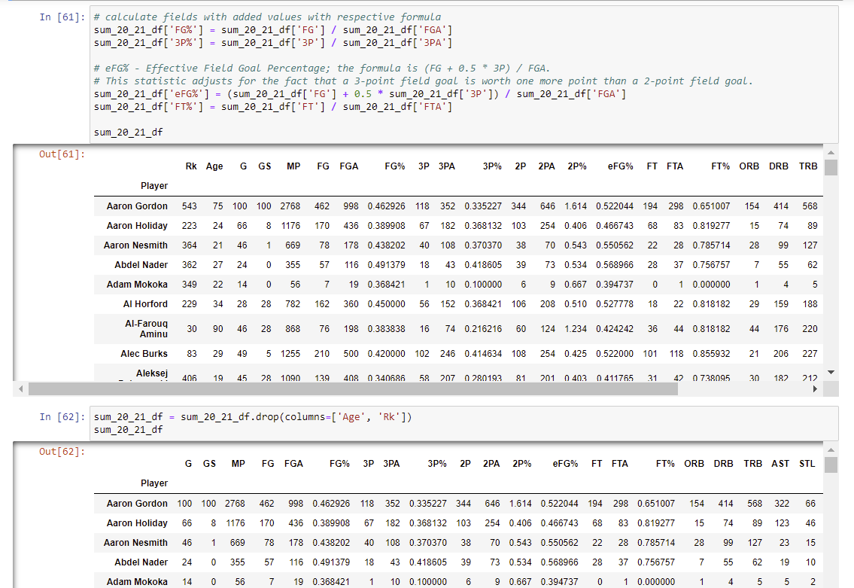
TRANSFORMATION #1. To produce statistical cleaned data
Recalculate calculated values (f.ex. %)
Drop unnecessary columns

Slide 19
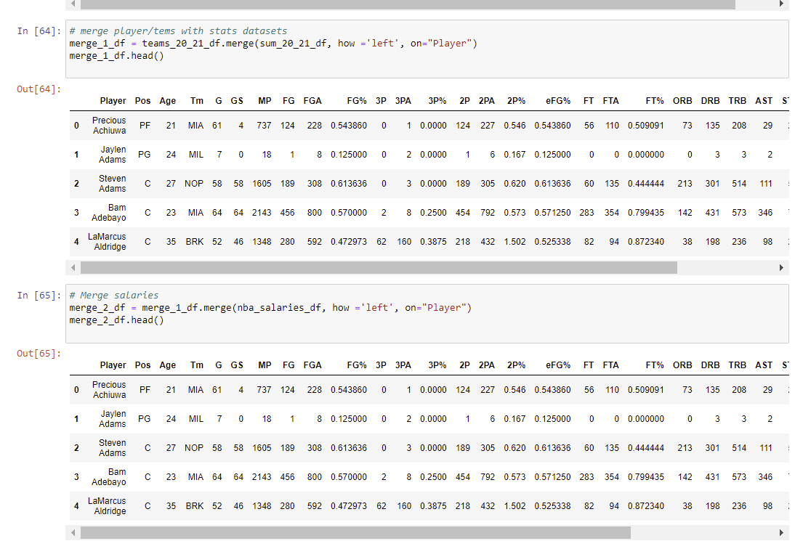
TRANSFORMATION #1. To produce statistical cleaned data
Merge 3 datasets consecutively

Slide 20
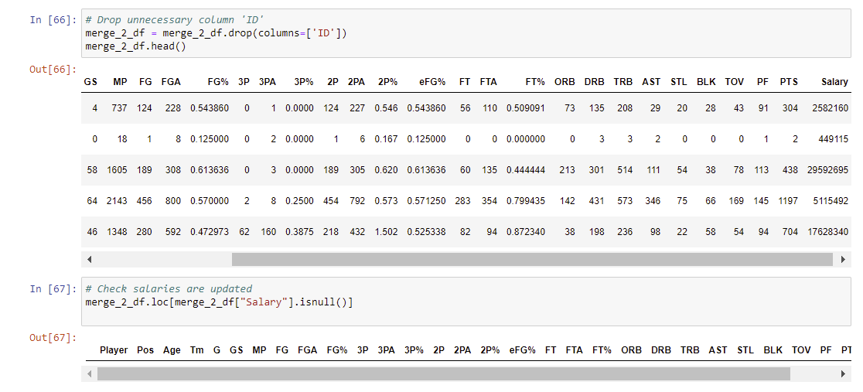
TRANSFORMATION #1. To produce statistical cleaned data
Final drop
Check salaries are updated

Slide 21
AGENDA
PROJECT DESCRIPTION
PROJECT REQUIREMENTS
SOURCES
ETL
EXTRACTION
TRANSFORMATION
LOAD
USER INTERFACE & VISUALIZATIONS
CONCLUSIONS

Slide 22
AGENDA
PROJECT DESCRIPTION
PROJECT REQUIREMENTS
SOURCES
ETL
EXTRACTION
TRANSFORMATION
LOAD
USER INTERFACE & VISUALIZATIONS
CONCLUSIONS

Slide 23
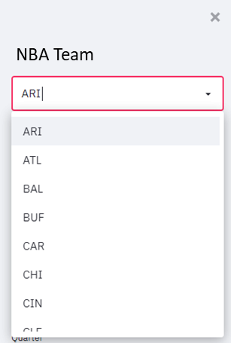
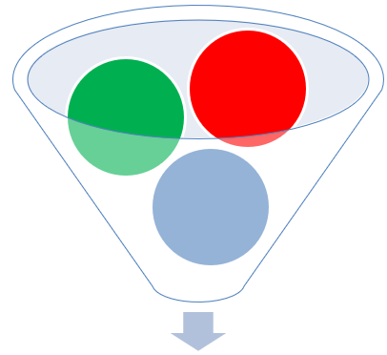
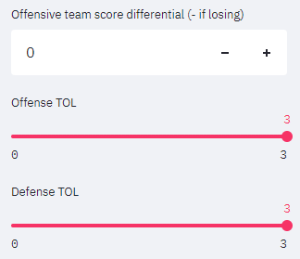
Design / Steps
STEP 1.- Select specific team
Select specific player
STEP 2.- Selected player will have specific performance reflected in stats.
Specific performance data can be loaded as defaults to make corrections using additional tools, like sliders, filters, etc?
DATA.- Will be collected from:
Kaggle
NBA stats
https://www.basketball-reference.com/leagues/NBA_2021.html
https://hoopshype.com/salaries/players/

Slide 24

Design / Steps (2)
CLOSEST PLAYER PERFORMANCE COMPARISON
XXXXX
Most similar
Including every stat and similar performance
Explain salary size dots
Color red or team colors
Team colors dictionary if possible
Glossary
SALARY
Specific players have contracts and salaries. Do we want to filter players also with salary data to respect salary caps?

Slide 25
Design / Steps (3)
STEP 3.- Apply models and machine learning to make proper forecasting / predictions
Will make up to 5 recommendations:
Closest player
Closest player including salary

Slide 26
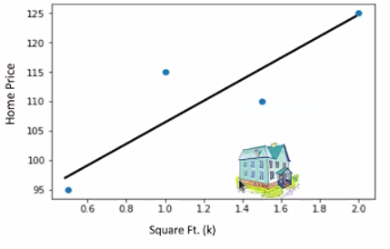
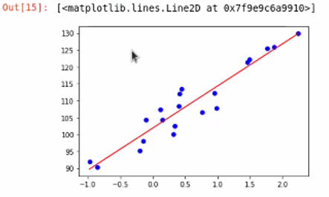
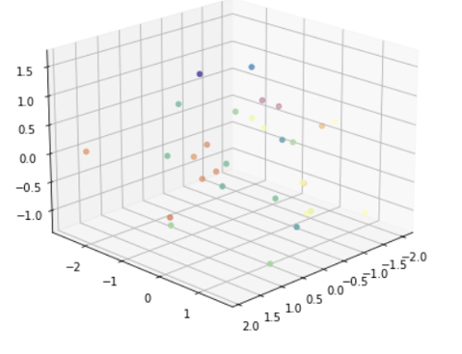
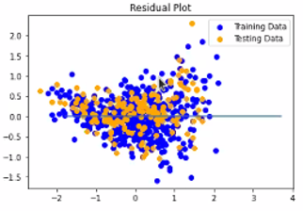

MODELS
Clustering
Euclidean distance

Slide 27
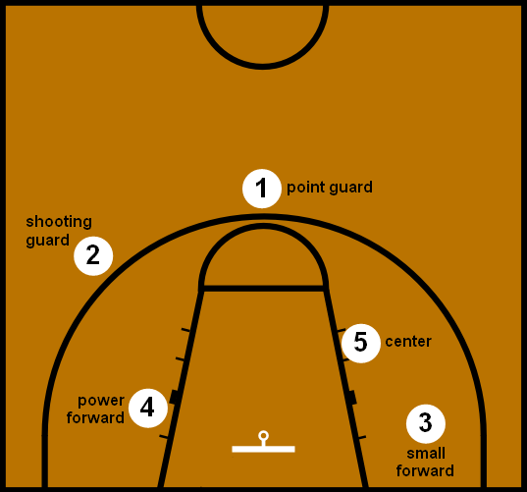
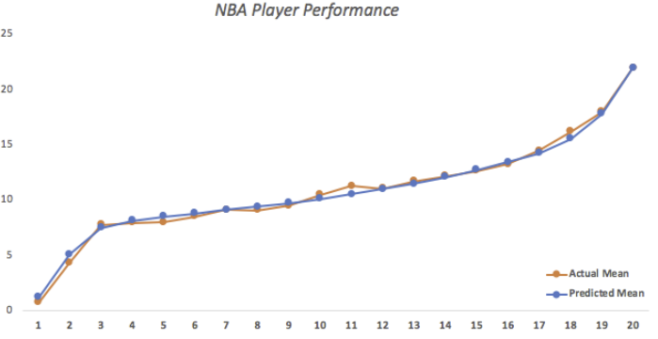
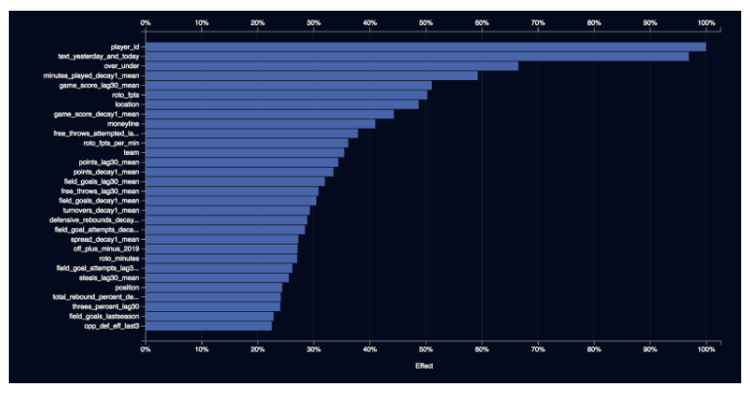
VISUALIZATIONS
To be determined:
Pyvis, network graph
Maxplotlib

Slide 28



Slide 29
BACK UP
29

Slide 30
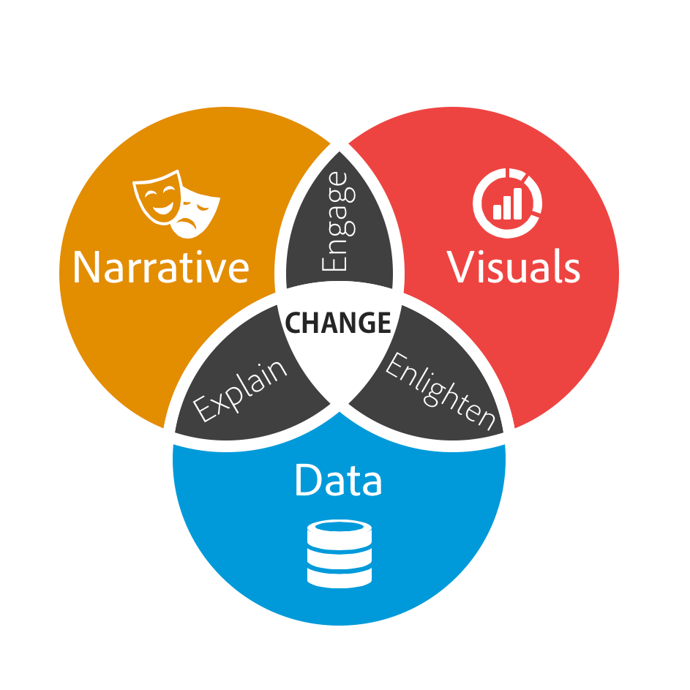

Slide 31
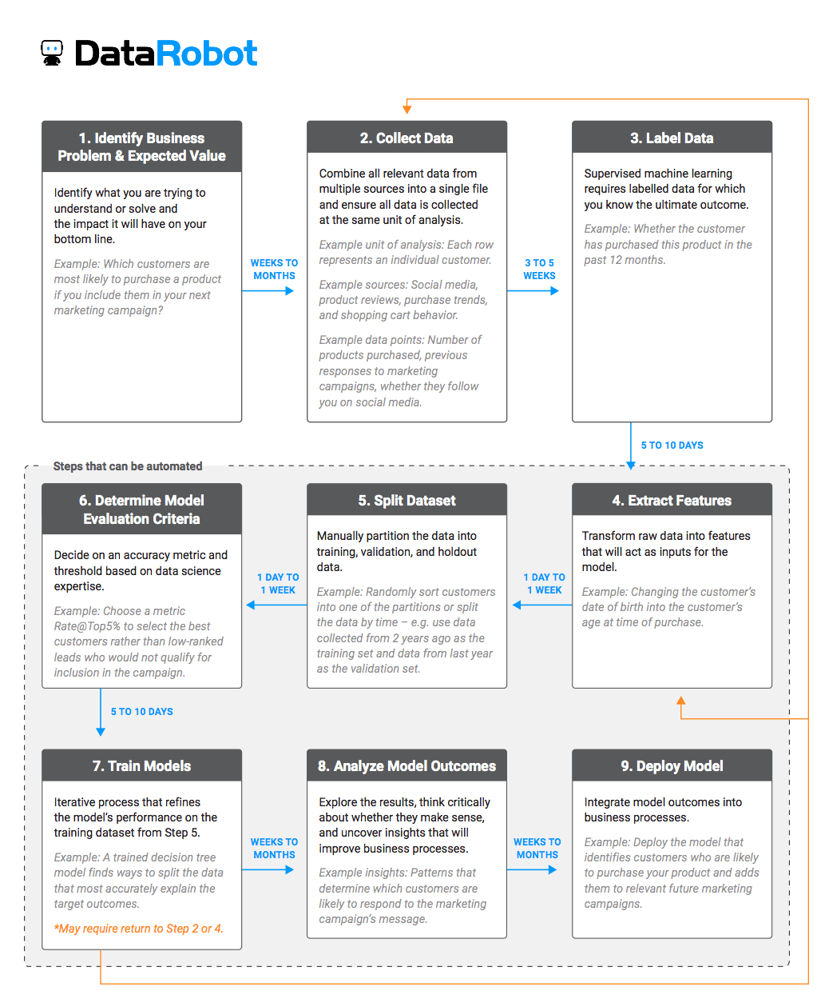

Slide 32
